Slide 1

Quest for the holy grail: the stock-recruitment curve in fishery stock assessment
Mark Maunder and Kevin Piner

Slide 2
Outline
What is productivity?
What influences productivity?
Does the stock-recruitment relationship make sense?
Is there a stock-recruitment relationship?
Can we estimate the stock-recruitment relationship?
Do we need to worry about the stock-recruitment relationship?
Recommendations

Slide 3
What is productivity?

Slide 4
Is it the surplus production function?

Slide 5
Stock Assessment Requirements
Production function
Absolute scaling
Depletion

Slide 6
Production function: a combination of YPR and S-R

Slide 7
Components of the production function
YPR
Natural mortality
Growth
Selectivity
Recruitment
The stock-recruitment relationship
R₀
(temporal variation in recruitment)

Slide 8
What influences productivity?

Slide 9
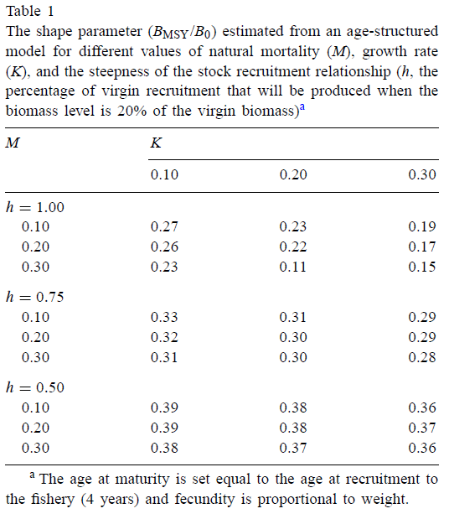
How sensitive is the production function to steepness?
Most influence
Maunder, M.N. (2003) Is it time to discard the Schaefer model from the stock assessment scientist’s toolbox? Fisheries Research, 61: 145-149.

Slide 10
MSY/B_{MSY} ≈ F_{MSY} = f(r)
h = 1.00
M |  | K
 | 0.10 | 0.20 | 0.30
0.10 | 0.10 | 0.17 | 0.25
0.20 | 0.18 | 0.32 | 0.52
0.30 | 0.31 | 1.00 | 1.00
Most influence
h = 0.75
M |  | K
 | 0.10 | 0.20 | 0.30
0.10 | 0.07 | 0.10 | 0.13
0.20 | 0.12 | 0.18 | 0.24
0.30 | 0.18 | 0.27 | 0.36
h = 0.50
M | K
 | 0.10 | 0.20 | 0.30
0.10 | 0.04 | 0.06 | 0.07
0.20 | 0.07 | 0.10 | 0.12
0.30 | 0.10 | 0.14 | 0.18

Slide 11
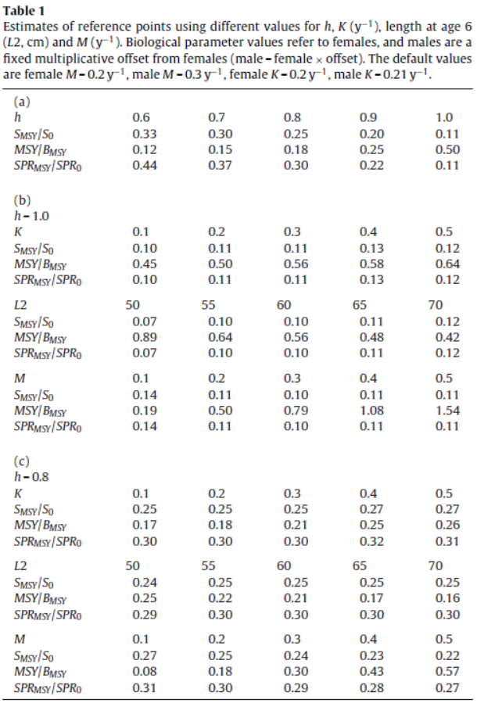
Summer flounder
Steepness
Estimation
Natural mortality
Natural mortality
Maunder M.N. (2012) Evaluating the stock-recruitment relationship and management reference points: Application to summer flounder (Paralichthys dentatus) in the U.S. mid-Atlantic. Fisheries Research, 125–126: 20–26.

Slide 12
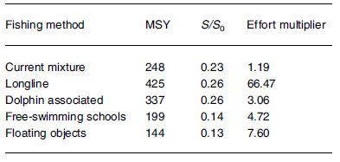
Management: yellowfin tuna selectivity
Maunder, M.N. (2002). The relationship between fishing methods, fisheries management and the estimation of MSY. Fish and Fisheries, 3: 251-260.

Slide 13
How much loss in yield is due to the stock-recruitment curve?
Components
Stock-recruitment steepness
Fishing mortality based loss in YPR
Selectivity based loss in YPR
(Assessment error due to misspecified steepness)
Method
Estimate maximum YPR from knife edge selectivity and varying age at entry to the fishery
Calculate YPR versus F for different age at entry to the fishery
Calculate the loss in recruitment corresponding to the F for different Stock-recruitment steepness

Slide 14
Model
M = 0.2
K = 0.2
Amat = 4
Avuln max YPR = 7 (F =∞)
Beverton-Holt

Slide 16
Hilborn’s “Pretty Good
Yield” = 80%

Slide 17
Age at first entry = 5

Slide 18
Sensitivity of sock assessments
Does steepness influence estimates of depletion?

Slide 19
Catch curve: depletion
Stock-recruitment
Z = M
Z = M + F
Fishing
Mortality

Slide 20
Catch curve: depletion
Stock-recruitment
Z = M
Z = M + F (h=0.75)
Z = M + F (h=1)
Fishing Mortality
+ recruitment

Slide 21
Information on h
No direct information in catch curve on h
More direct information on M
Why we have a better chance at estimating M compared to h (see Lee et al. papers)

Slide 22
Steepness’ double whammy
Makes the stock more depleted
Makes Bmsy/B0 reference point higher

Slide 23
Sensitivity of sock assessments
YPR depletion
Composition data
CPUE decline due to C (C/B = F)
S-R = recruitment reduction
Relative index for full catch history time series constrains depletion
Total catch history model versus starting from exploited population size.

Slide 24
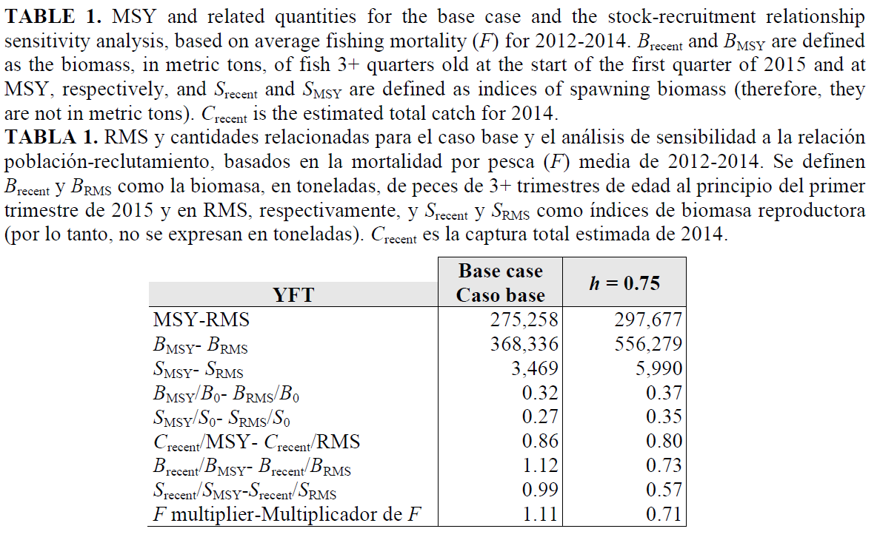
Yellowfin tuna in the EPO
Scur/S0 0.27 0.20
Scur 3434 3414

Slide 25
Bigeye tuna in the EPO
Scur/S0 0.22 0.25
Scur 115012 177288
Assessment impact

Slide 26
Mispecifying steepness can influence estimates of abundance, important for decision rules: Pacific cod

Slide 27
Does the stock-recruitment relationship make sense?

Slide 28


Slide 29
Traditional models: Beverton-Holt and Ricker
Their derivation is based on solving the differential equation for the abundance, N, as a function of mortality, Z.
.
Beverton-Holt model
Z is a linear function of the cohort abundance, which represents process like intra-cohort competition,
Ricker
Z is a linear function of the spawner abundance, which represents process like cannibalism, (E is eggs or adults)

Slide 30
Traditional models: Beverton-Holt and Ricker
These differential equations are solved to produce equations that calculate recruitment as a function of spawning biomass
Beverton-Holt
Ricker

Slide 31
Recruitment in terms of survival: Beverton-Holt and Ricker
The stock recruitment relationships can be described in terms of survival, S, from birth to the age at recruitment
Beverton-Holt
Ricker

Slide 33
Survival implications of the Beverton-Holt and Ricker models

Slide 34
Problems with Beverton-Holt and Ricker stock-recruitment models
Density dependence is unlikely to be linear
Density dependence is not continuous at a constant rate
Density dependence probably occurs at a critical stage/period
Changes in survival due to density dependence should be strongest close to the carrying capacity
Despite the above, the general shapes of the Beverton-Holt and Ricker make intuitive sense

Slide 35
Expected survival
Survival
Eggs
Carrying capacity

Slide 36
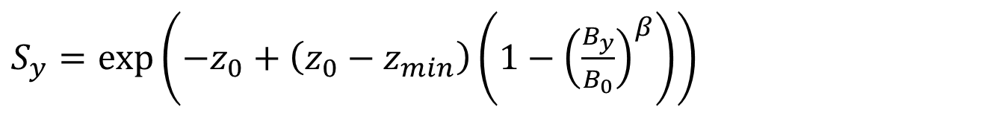
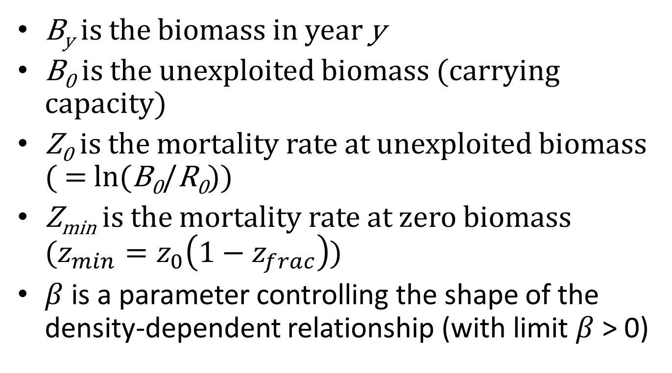
$S_{y}=exp\left({−z}_{0}+\left(z_{0}−z_{min}\right)\left(1−{\left(\frac{B_{y}}{B_{0}}\right)}^{β}\right)\right)$
B_{y} is the biomass in year y
B₀ is the unexploited biomass (carrying capacity)
Z₀ is the mortality rate at unexploited biomass ( = ln(B₀/R₀))
Z_{min} is the mortality rate at zero biomass ($z_{min}=z_{0}\left(1−z_{frac}\right)$)
$β$ is a parameter controlling the shape of the density-dependent relationship (with limit $β$ > 0)
Taylor et al. (2013) A stock-recruitment relationship based on pre-recruit survival, illustrated with application to spiny dogfish shark. Fisheries Research 142: 15– 21.

Slide 37
The Low fecund stock-recruitment relationship
Spawning biomass
Taylor et al. (2013) A stock-recruitment relationship based on pre-recruit survival, illustrated with application to spiny dogfish shark. Fisheries Research 142: 15– 21.

Slide 38
The Low fecund stock-recruitment relationship
Spawning biomass
Taylor et al. (2013) A stock-recruitment relationship based on pre-recruit survival, illustrated with application to spiny dogfish shark. Fisheries Research 142: 15– 21.

Slide 39
Adult carrying capacity versus egg carrying capacity
Adult survival
Survival
Egg survival
Egg carrying capacity
0
1
B/B0

Slide 40
Survival: hockey stick S-R model

Slide 41
A stock–recruitment model for highly fecund species based on temporal and spatial extent of spawning
Recruitment
Maunder, M.N. and Deriso, B.R. (2013) A stock–recruitment model for highly fecund species based on temporal and spatial extent of spawning. Fisheries Research 146: 96–101.
Spawning biomass

Slide 42
Expansion into unfavorable spawning habitat
Recruitment
Unproductive
habitat
Spawning biomass

Slide 43



Strong density dependence

Slide 44



Strong density dependence?

Slide 45
Is there a stock-recruitment relationship?

Slide 46

Crusade against steepness deniers

Slide 47
Pacific Sardine

Slide 48
Pacific Sardine

Slide 49
Pacific Sardine

Slide 50
Yellowfin tuna in the EPO

Slide 51
Yellowfin tuna in the EPO

Slide 52
Yellowfin tuna in the EPO

Slide 53
Bigeye tuna in the EPO

Slide 54
Bigeye tuna in the EPO

Slide 55
Bigeye tuna in the EPO

Slide 56
Summer flounder
High F

Slide 57
Summer flounder

Slide 58
Pacific cod

Slide 59
Pacific cod

Slide 60
Pacific cod

Slide 61
Pollock

Slide 62
Pollock

Slide 63
Pollock

Slide 64

Vert-pre et al. 2013. Frequency and intensity of productivity regime shifts in marine fish stocks PNAS 110: 1779–1784
Based on surplus production not just stock-recruitment

Slide 65
Can we estimate the stock-recruitment relationship?

Slide 66
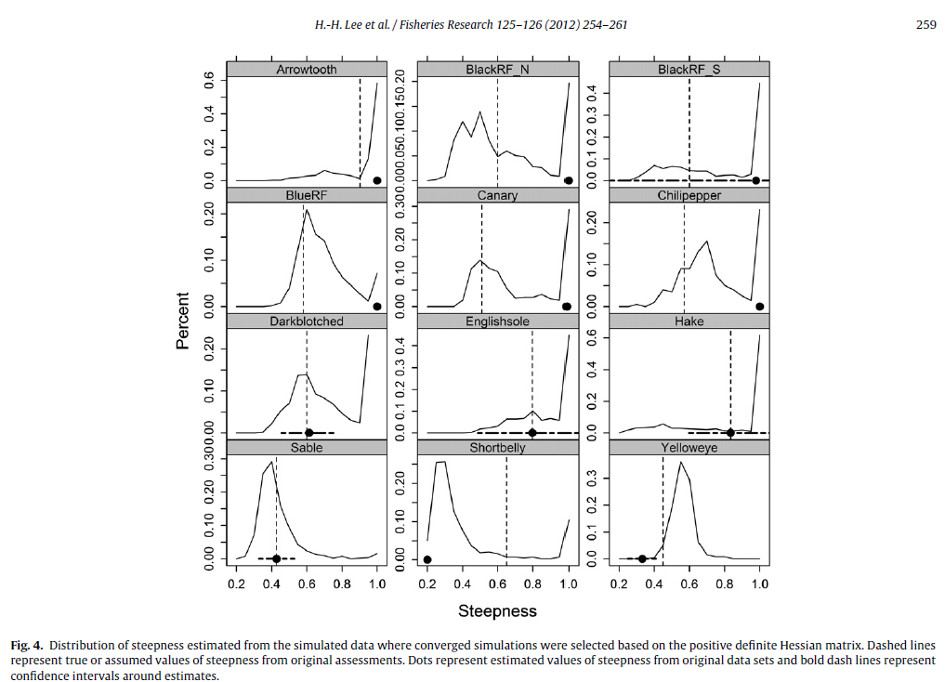
Bias in estimating steepness
Lee et al. (2012) Can steepness of the stock-recruitment relationship be estimated in fishery stock assessment models? Fisheries Research 125-126: 254-261.

Slide 67
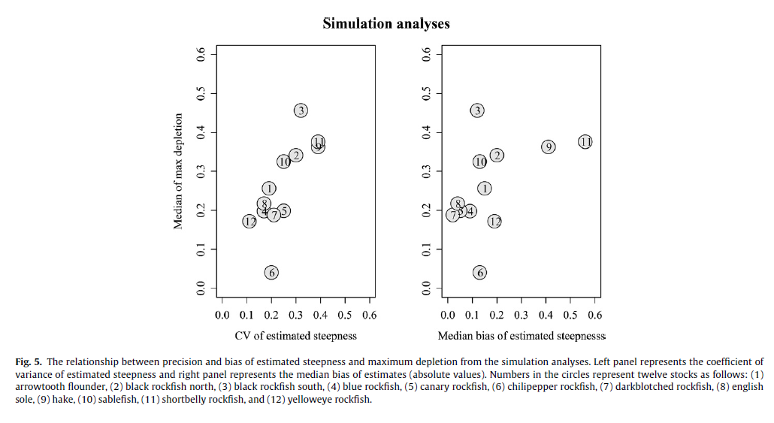
Information content
Lee et al. (2012) Can steepness of the stock-recruitment relationship be estimated in fishery stock assessment models? Fisheries Research 125-126: 254-261.

Slide 68
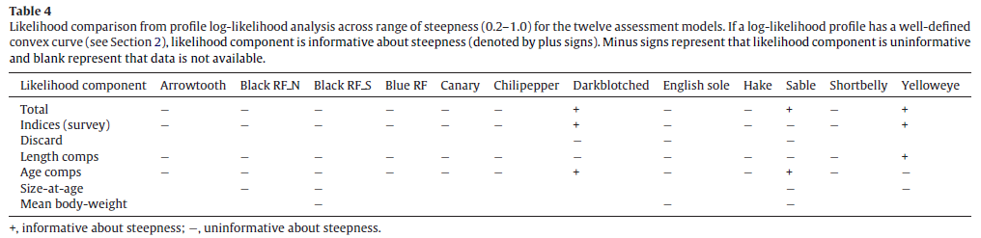
Information content
Lee et al. (2012) Can steepness of the stock-recruitment relationship be estimated in fishery stock assessment models? Fisheries Research 125-126: 254-261.

Slide 69
Do we need to worry about the stock-recruitment relationship?

Slide 70
How sensitive is the production function to steepness?
Maunder, M.N. (2003) Is it time to discard the Schaefer model from the stock assessment scientist’s toolbox? Fisheries Research, 61: 145-149.

Slide 71
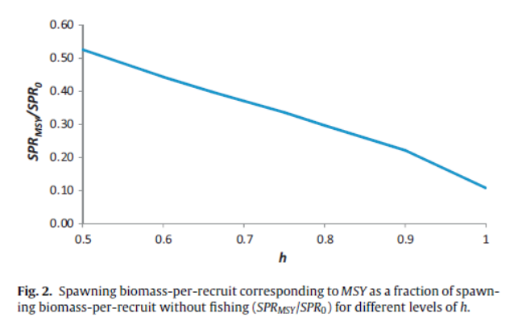
Proxy reference points imply a value for steepness: summer flounder
Maunder M.N. (2012) Evaluating the stock-recruitment relationship and management reference points: Application to summer flounder (Paralichthys dentatus) in the U.S. mid-Atlantic. Fisheries Research, 125–126: 20–26.

Slide 72
Proxy reference points imply a value for steepness: Pacific cod

Slide 73
Robust steepness assumptions
Zhu et al. (2012). Implications of uncertainty in the spawner-recruitment relationship for fisheries management: an illustration using bigeye tuna (Thunnus obesus) in the eastern Pacific Ocean. Fisheries Research 119– 120: 89– 93.

Slide 74
Yield curves
Yellowfin tuna
Summer flounder

Slide 75
Even if there is no stock-recruitment relationship the measure of fecundity influences reference point evaluation
Spawning biomass is used in the stock –recruitment relationship
Spawning biomass is used in the definition of biomass based reference points
Spawning biomass definition
Mature biomass
Mature female biomass
Mature numbers
Total biomass
Fecundity
The more weight given to younger fish in the spawning biomass definition, the more optimistic the results
Minte-Vera et al. (in prep) The influence of spawning biomass definition on stock assessment results and evaluation of reference points: an
illustration with yellowfin tuna in the eastern Pacific Ocean

Slide 76


Limit reference point 50% reduction in recruitment
Limit reference points designed to avoid something bad happening
Something bad happening is often interpreted as recruitment collapse
h = 0.75
r = 0.5
d = 0.077
Maunder, M.N. and Deriso, R.B. 2014. Proposal for biomass and fishing mortality reference points based on reduction in recruitment. IATTC Stock Assessment Report 14: 193-206.

Slide 77
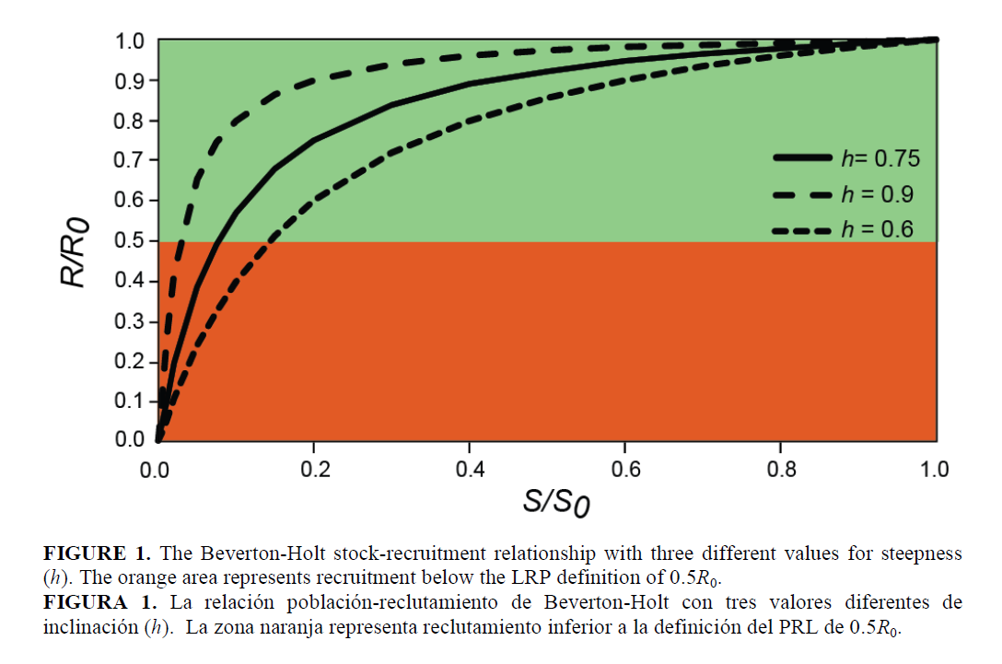

Slide 78
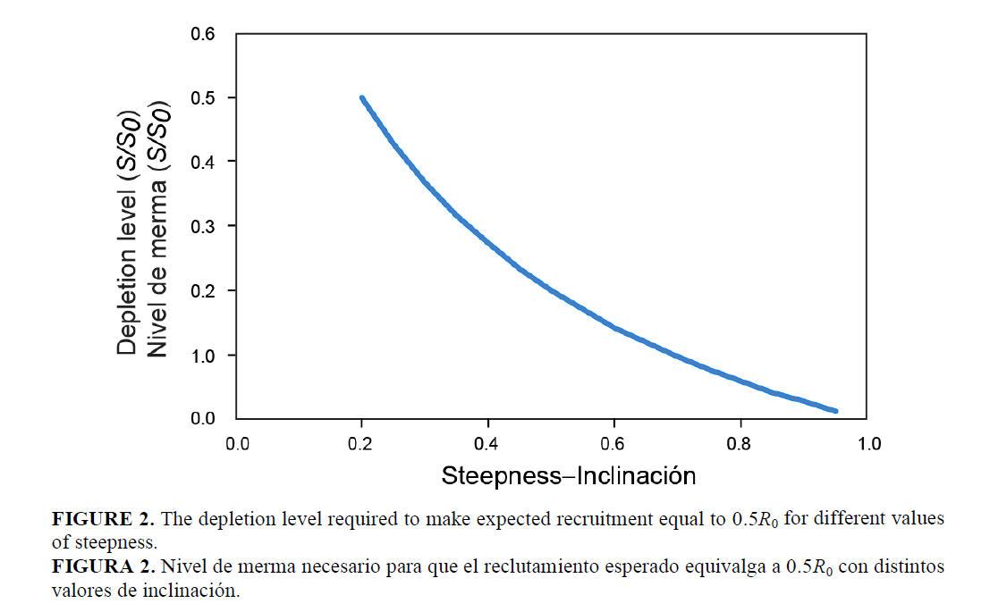

Slide 79
Pretty good yield
E.g. 95% of MSY (Maximum YPR)
Does F95%C_{Fmax} work if h < 1
Short term losses rebuilding to B95%MSY
Don’t manage on yield, manage on CPUE, consistency, size of fish, ….
Use F based management because of temporal variation in recruitment
Limit reference points
Vulnerable biomass (CPUE) = 50% that at F95%
Average length = 50% that at F95%
Spawning biomass (CPUE) = 50% that at F95%
R = 50%R_F95%MSY [h=0.75]

Slide 80
Dynamic reference points: recruitment temporal variability in bigeye tuna
Wang, S-.P., Maunder, M.N., Aires-da-Silva, A. And Bayliff, W.H. (2009) Evaluating fishery impacts: application to bigeye tuna (Thunnus obesus) in the eastern Pacific Ocean. Fisheries Research 99: 106-111.

Slide 81
Main concepts

Slide 82
Catch curve: depletion
Stock-recruitment
Z = M
Z = M + F (h=0.75)
Z = M + F (h=1)
Mortality + recruitment

Slide 83
Steepness’ double whammy
Makes the stock more depleted
Makes Bmsy/B0 reference point higher

Slide 84
Adult carrying capacity versus egg carrying capacity
Adult survival
Survival
Egg survival
Egg carrying capacity
0
1
B/B0

Slide 85
Expansion into unsuitable spawning habitat
Recruitment
Unproductive
habitat
Spawning biomass

Slide 86
Strong density dependence?

Slide 87
Robust steepness assumptions
Zhu et al. (2012). Implications of uncertainty in the spawner-recruitment relationship for fisheries management: an illustration using bigeye tuna (Thunnus obesus) in the eastern Pacific Ocean. Fisheries Research 119– 120: 89– 93.

Slide 89
The real holy grail
Natural mortality
Absolute abundance

Slide 90
Recommendations
Don’t include the stock-recruitment relationship in the stock assessment
Focus on estimating natural mortality and absolute abundance
Don’t let (length) composition data drive abundance
Change selectivity to improve yields (discard mortality)
Fish at < Fmax (short term losses)
Focus on non-MSY management goals
Use effort or F based management

Slide 92

Steepness believers

Slide 94
Other ideas

Slide 95
Steepness < 1 makes assessment hard
Total catch history model
If h < 1 only a very small range of R0s work
Convergence issues

Slide 96
Alternatives to precautionary reference points that include uncertainty about steepness
Lower bound of the steepness confidence interval
Need to simulation test for bias
Using the precautionary proxy reference point to generate a prior for steepness
See Martell’s method
Information in data pulls h away from conservative value
Lower value for h may mean short term loss in yield even if equilibrium yield is similar
Mispecifying steepness may bias biomass estimates used in decision rules

Slide 97
Natural mortality may be more important: summer flounder
No flat yield curve
Very influential for exploitation rates

Slide 98
Size of the fish caught may be more important
It may be easier to improve yield by increasing the yield per recruit by catching larger fish than estimating steepness to optimize exploitation rates

Slide 99
Dynamic reference points
Recruitment temporal variability
Selectivity temporal variability

Slide 100
Dynamic reference points: recruitment temporal variability in bigeye tuna
Wang, S-.P., Maunder, M.N., Aires-da-Silva?, A. And Bayliff, W.H. (2009) Evaluating fishery impacts: application to bigeye tuna (Thunnus obesus) in the eastern Pacific Ocean. Fisheries Research 99: 106-111.

Slide 101
Dynamic reference points: selectivity temporal variability in bigeye tuna

Slide 102

Another reason not to use surplus production models
Interpretation of CPUE data needs recruitment estimates
Illustrated using the production model diagnostic
Minte-Vera, C., Maunder, M.N., Aires-da-Silva, A.M., Satoh, K., Uosaki, K., (in press). Get the biology right or use size-composition data at your own peril. Fish. Res.

Slide 106
-Standard stock-recruitment theory does not make sense
Density dependence is not a constant continuous process, it happens in stages
-survival as a function of spawning biomass
Spatial argument
-there is no stock-recruitment relationship for most highly fecund species
-if there is a relationship it probably occurs at biomass levels where other factors are more important
-and you can't estimate it anyway
-growth is relatively well known (if you are not using it to fit to length comps)
-so what we need for assessment and management is natural mortality and absolute abundance, which are both poorly determined
-priority should be given to estimating these two parameters
Under a good selectivity strategy, what is Smaxypr/S0?

Slide 107
Does including steepness in es5timation model change estimates, or is it just for projections and reference points
Is spawning biomass measurement important for stock-recruitment or just for reference point calculations
Jiangfengs better to under assume
Regime shifts in recruitment
With S-R small changes in R0 cause the model to crash if there is a stock-recruitment relationship and the population is highly depleted.

Slide 108
What we need
A test to determine between recruitment influencing spawning biomass and spawning biomass determining recruitment.

Slide 109
Abstract
Specification of the stock-recruitment relationship in fisheries stock assessment models is like the quest for the holy grail as depicted in modern literature. Everyone believes it exists, but no one can find it amongst the noise in the data. Strong leads to its existence, which are pursued without caution, turn out to be just quirks in the data. If you get a glimpse, it is just an aberration that disappears as quickly as it appears as more data are collected or model assumptions are changed. However, the rewards are so high in terms of both academic achievement and management consequences, that we relentlessly continue the search ignoring everything else. Pieces of evidence, no matter how unreliable, are put together in meta-analysis, propagating the same deception, but with more power. The theory that directs our search is flawed and in reality there is only a weak relationship between recruitment and stock size for most highly fecund species. The stock-recruitment relationship is probably not important unless the population gets to such low levels that other factors should have already triggered management action. Therefore, research should focus rather on improving estimates of absolute abundance and natural mortality, and management strategies that are robust to uncertainty in these two quantities.

Slide 111
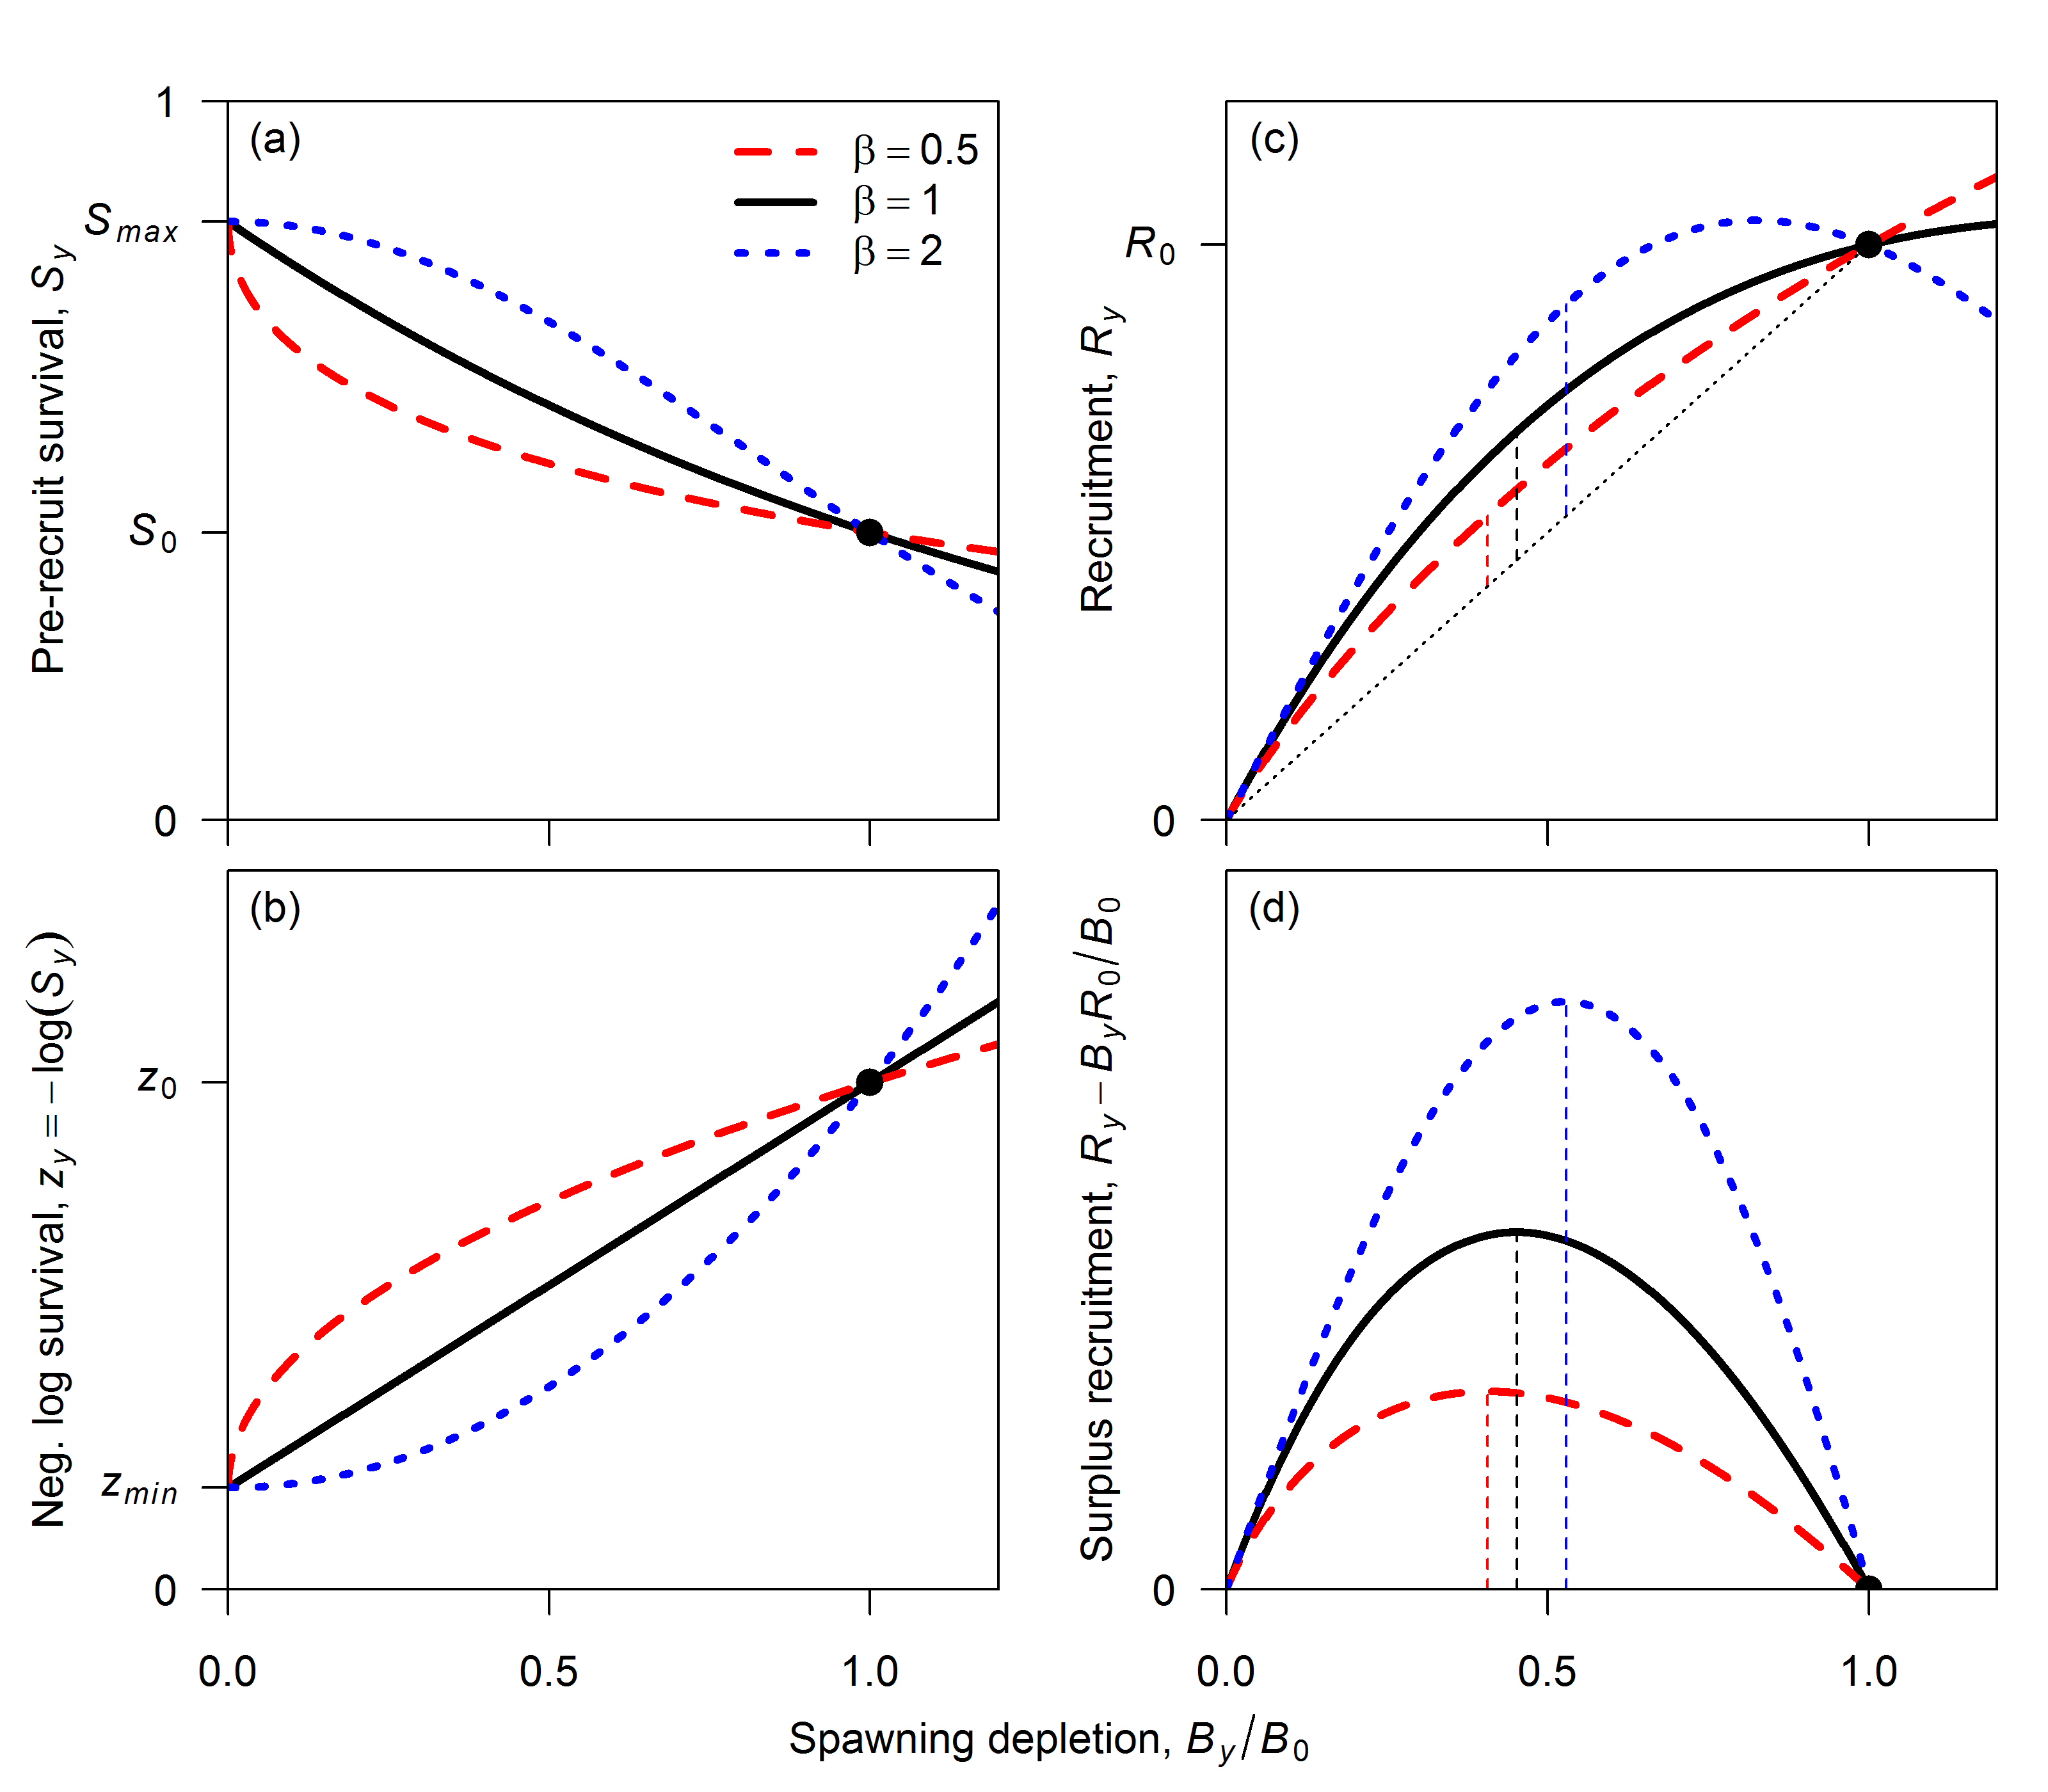

Slide 113
Reference points depend on steepness: summer flounder
Maunder M.N. (2012) Evaluating the stock-recruitment relationship and management reference points: Application to summer flounder (Paralichthys dentatus) in the U.S. mid-Atlantic. Fisheries Research, 125–126: 20–26.

Slide 114
Sensitivity of sock assessments
Does steepness influence estimates of depletion?
Composition data = F = YPR depletion
CPUE decline due to C = B; C/B = F = YPR depletion
S-R = recruitment reduction
Relative index for full catch history time series = depletion is fixed.
Total catch history model versus starting from exploited population size.

Slide 115
Age at first entry into the fishery = 4 = age at maturity???

Slide 116
Conclusions
Stock-recruitment steepness, mortality based loss in YPR, and selectivity based loss in YPR can all have about the same impact on yield
Sensitivity to other parameters greater at high steepness
The relative impact of Stock-recruitment steepness interacts with the age at first entry into the fishery
Loss due to YPR occurs at low fishing mortalities and loss due to S-R occurs at high fishing mortalities
Stock-recruitment may or may not have an impact on assessment results dependent on the application and the quantity of interest

Slide 117
Conclusions
Stock-recruitment relationships are much more complex than standard theory
Density dependence may occur at much lower abundances than the unfished biomass
The mechanisms for strong density dependence are unclear

Slide 118
Conclusions
Annual recruitment variation drives fluctuations in spawning biomass
Regime shifts in recruitment drive the apparent stock-recruitment relationship
Autocorrelation/regime shifts in recruitment relative to age at maturity and maximum age will determine apparent stock-recruitment relationships

Slide 119
Conclusions
The stock-recruitment curve, if it exists, is important for management
Assuming a lower steepness may not reduce long term yield by much, but may cause short term losses
The assumption of steepness influences both estimates of depletion and the reference points

Slide 120
Conclusions
Even in simulated conditions estimation is problematic
Estimates are probably an artifact of “quirks” in the data (e.g. regime shifts)
In reality, we probably can’t estimate the stock-recruitment relationship

